Slide 1

Practical Introduction to Open Telecom Platform
HTTP Rest Workshop

Slide 2

Agenda
Check Dev Env
Erlang Review
OTP Behaviors
Applications
Gen Servers
Supervisors
Rebar3
Mnesia DB
Cowboy Webserver
Tutorial
Notes:
Declarative/functional: no shared state, no mutation, recursion, no global namespace
Concurrent: "multiple processes executing during the same period of time". Might not be in parallel
Parallel: execution literally occurs at the same instant, for example on separate processors of a multi-processor machine
Soft: the usefulness of a result degrades after its deadline, thereby degrading the system's quality of service.

Slide 3
Vagrant Setup
git clone https://github.com/austinerlang/RESTapi
vagrant up
vagrant ssh
Notes:
Declarative/functional: no shared state, no mutation, recursion, no global namespace
Concurrent: "multiple processes executing during the same period of time". Might not be in parallel
Parallel: execution literally occurs at the same instant, for example on separate processors of a multi-processor machine
Soft: the usefulness of a result degrades after its deadline, thereby degrading the system's quality of service.

Slide 4
Erlang Characteristics
1986, open sourced in 1998
Declarative
Concurrent
Distributed
Fault Tolerant
Soft real-time
Open Telecom Platform (OTP)
Efficient Virtual Machine
Dynamic / Strong typing
Garbage Collected
99s of uptime?
… a style of building the structure and elements of computer programs, that expresses the logic of a computation without describing its control flow.
http://en.wikipedia.org/wiki/Declarative_programming
1> A = 10.
10
2> A div 2.
5
3> A div 2.0.
** exception error: an error occurred when evaluating an arithmetic expression
in operator div/2
called as 10 div 2.0
Notes:
Declarative/functional: no shared state, no mutation, recursion, no global namespace
Concurrent: "multiple processes executing during the same period of time". Might not be in parallel
Parallel: execution literally occurs at the same instant, for example on separate processors of a multi-processor machine
Soft: the usefulness of a result degrades after its deadline, thereby degrading the system's quality of service.

Slide 5
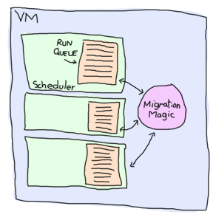
BEAM: Björn's Erlang Abstract Machine
1> Fun = fun() -> receive after infinity -> ok end end.
#Fun<...>
2> {_,Bytes} = process_info(spawn(Fun), memory).
{memory,1232}
Lightweight processes
  Millions!
  1232 bytes of memory
Garbage Collection per process
Message passing
Multi-core
Scheduling
  2k reductions
  yield/bump_reductions..
  Fast context switching
Hitchhiker's guide to the Erlang VM
learnyousomeerlang.com

Slide 6
Erlang Shell
Interactive environment
Everything ends with a full stop.
c(moduleName). to compile your code
VM inspection i.e. observer:start(), regs(), i(), …
help(). for a list of commands
Ctrl-c and Ctrl-d to break a loop
$ erl
Erlang/OTP 17 [erts-6.3] [source] [64-bit] [smp:4:4] [async-threads:10] [hipe] [kernel-poll:false]
Eshell V6.3 (abort with ^G)
1>

Slide 7
Erlang Basics
1> One.
* 1: variable 'One' is unbound
2> One = 1.
1
3> Un = Uno = One = 1.
1
4> Two = One + One.
2
5> Two = 2.
2
6> Two = Two + 1.
** exception error: no match of right hand side value 3
7> two = 2.
** exception error: no match of right hand side value 2
Variables
  No global scope
  No mutation
  Uppercase
Functions
  module:fun()
  Private/Public
  Pass by reference
  Eager evaluation
  Anonymous
Pattern Matching
  Assignment
  Functions
Notes:
Rest assured that for function calls, each argument is passed as a
single word only: either a pointer, or an "immediate" value (e.g.,
atoms, and integers smaller than about 28 bits - or about 60 bits
on a 64-bit machine). Erlang doesn't even have a built-in "clone"
function, since there is no need for it: there are no destructive
update operations.
- Richard Carlsson
Yes, basically, everything, both arguments and return values, is passed "by reference". But, as you say, this is not noticeable as you can't change a value.
- Robert Virding

Slide 8
Data types
Atoms
Binaries/Bitstrings
Booleans (as atoms)
Funs
Lists (and strings)
Numbers
Tuples
Unique identifiers (pids, ports, references)

Slide 9
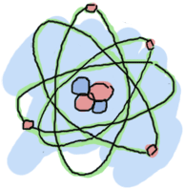
Data types: Atoms
Constant literals that stand for themselves (similar to enums)
My_var is a variable my_var is an atom
4 - 8 bytes/atom
Not garbage collected so don't dynamically create them
Some are reserved words
1> atom.
atom
2> atoms_rule.
atoms_rule
3> atoms_rule@erlang.
atoms_rule@erlang
4> 'Atoms can be cheated!'.
'Atoms can be cheated!'
5> atom = 'atom'.
atom
learnyousomeerlang.com

Slide 10
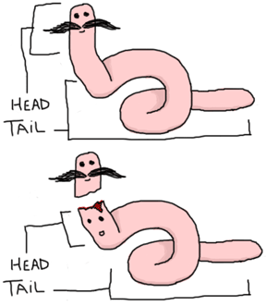
Data types: Lists
Eshell V6.3 (abort with ^G)
1> [Head|Tail] = [1, 2, 3].
[1,2,3]
2> Head.
1
3> Tail.
[2,3]
4>
….....
5> [1 | []].
[1]
6> [2 | [1 | []]].
[2,1]
7> [3 | [2 | [1 | []] ] ].
[3,2,1]
* note proper lists aren't required
Most used data structure
Store any erlang data
Very efficient (BIFs)
[Head|Tail] = [1, 2, 3].
Pipe is the cons operator
true = [a,b,c] < [a,b,x,d]
Not like in Scheme
(cons 1 (cons 2 '()))
> (1 2)
vs.
(cons 1 2)
> (1 . 2)
learnyousomeerlang.com

Slide 11
Data types: Strings
Eshell V6.3 (abort with ^G)
1> "Hello".
"Hello"
2> A = "Hello".
"Hello"
3> [H|T] = "Hello".
"Hello"
4> H.
72
5> [$H, $e, $l, $l, $o].
"Hello"
6> [$H, $e, $l, $l, $o] = "Hello".
"Hello"
7> "abcd" = [97,98,99,100].
"abcd"
8> "Hel" ++ "lo".
“Hello”
Strings are lists of ASCII values
$A, $B, $\n ... to access ASCII values
“Hello”.
String Concatenation:
realloc, and a memcpy O(N) time
VS.
non-contiguous chunks of memory O(1) time

Slide 12
Data types: Tuples
Ordered finite sets
Store any erlang data
{Element1, Element2, ..., ElementN}
Tagged tuples: {tag, value}
{A, B} = {1, 2}.
  > A = 1
  > B = 2
1> element(2, {one, two}).
two
2> tuple_size({one, two}).
2

Slide 13
Data types: Binary/Bitstring
integer | float | binary | bytes | bitstring | bits | utf8 | utf16 | utf32
signed | unsigned
big | little | native
1> <<Var/integer-signed-little>> = <<97>>.
<<”a”>>
<< 0, 1, 2 … 255 >>.
<<”hello”, 32, “there”>>.
Value:Size/TypeSpecifierList
Size is in bytes
Bitstrings can be any length
%% Parse a buffer
parse_buffer(BufferAll, Bytes) ->
case BufferAll of
<<Data:Bytes/binary, Buffer/binary>> -> {Data, Buffer, Bytes};
<<Data/binary>> -> {Data, <<>>, erlang:size(Data)}
end.

Slide 14
Pattern Matching
A = 1.
A = 2.
  ** exception error: no match of right hand side value 2
{A, B, C} = {1, 2, 3}
This call: function({1, 2, 3})
  Will match: function({A, B, C}) → … do something with A
Same principle with lists [] and binaries <<>>

Slide 15
Modules
-module(name). Must match filename.erl
-export([fun/arity, fun2/arity, …]).
-compile(export_all).
%%% Module comments
%% function comments
% inside function comments
Compile modules with c(module) or erlc
Call functions with module:fun()

Slide 16
Message Passing
A-synchronous
Sent between processes by pid <0.30.0>
self() to get your own pid
Pid = spawn(m, f, [a]).
Pid ! msg
Printed process ids < A.B.C > are composed of:
A, the node number (0 is the local node, an arbitrary number for a remote node)
B, the first 15 bits of the process number (an index into the process table)
C, bits 16-18 of the process number (the same process number as B)

Slide 17
OTP
Enforce patterns via callbacks
Generic vs Specific
-behaviour( .... ).
  application
  gen_event
  gen_server
  gen_fsm
  supervisor
Benefits
  Productivity, reliability, well tested, easier to maintain
  ** Please open your templates for the next slides **

Slide 18
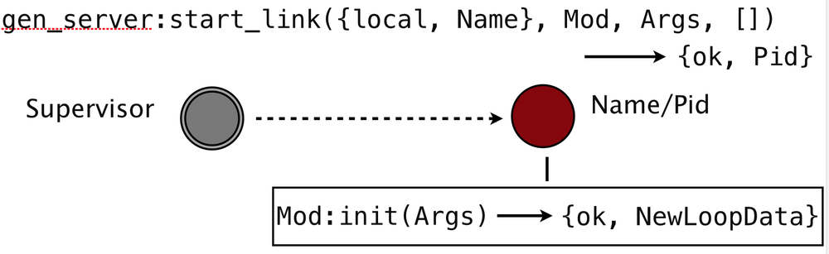
Gen Server Behavior - poop
gen_server
start_link/4
  Name is the process name
  Mod is the name of the callback module
  Args – list of arguments passed to the callback module
Init/1 is called by the server

Slide 19
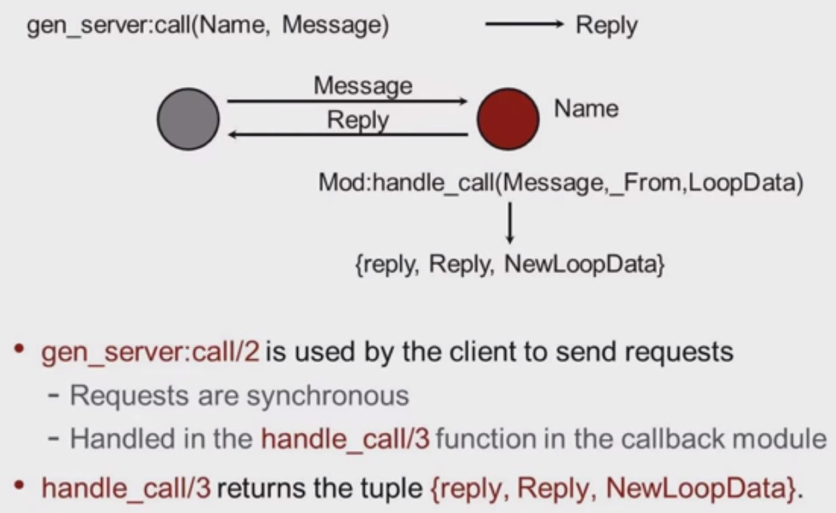
Gen Server Behavior – synchronous calls

Slide 20
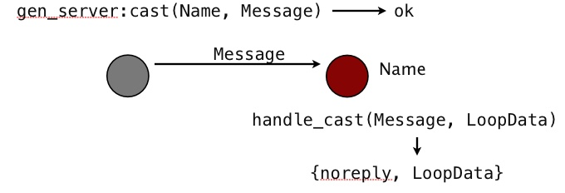
Gen Server Behavior – asynchronous calls

Slide 21
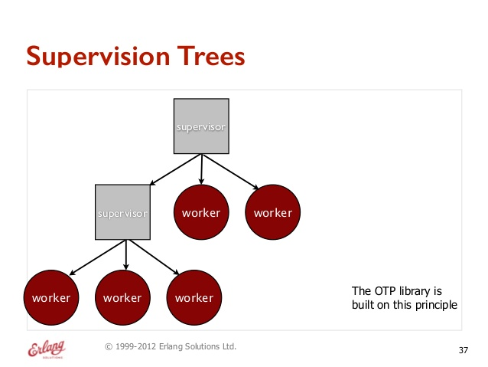
Supervisor Behavior

Slide 22
Supervisor Behavior – sup flags
sup_flags() = #{strategy => strategy(), % optional
intensity => non_neg_integer(), % optional
period => pos_integer()} % optional

Slide 23
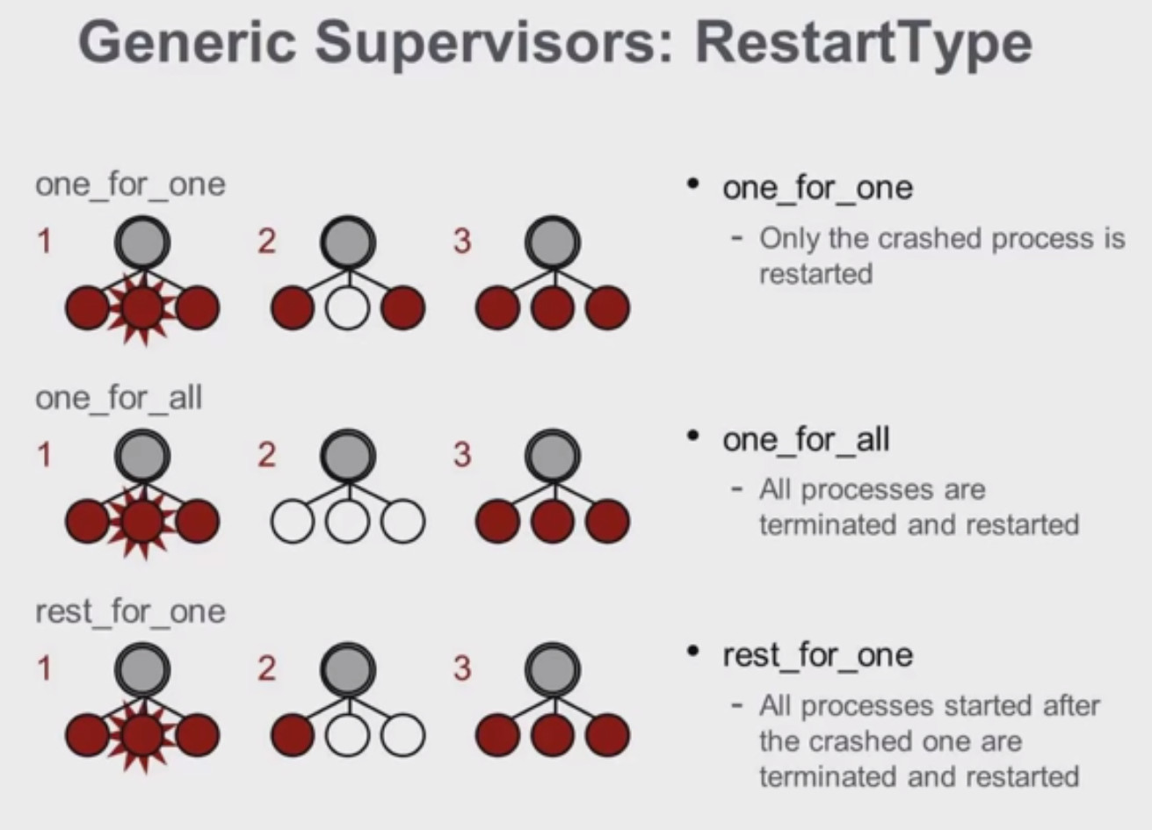
Supervisor Behavior – restart strategies

Slide 24
Supervisor Behavior – child spec
child_spec() = #{id => child_id(), % mandatory
start => mfargs(), % mandatory
restart => restart(), % optional
shutdown => shutdown(), % optional
type => worker(), % optional
modules => modules()} % optional

Slide 25
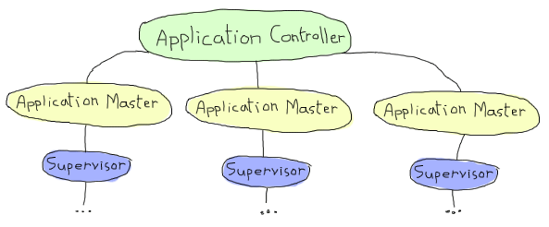
Application Behavior
Packaging your code files / behaviors
Libraries w/out supervision
Normal applications with supervision

Slide 26
Application Behavior – callback module
Application:start(Application).
Application:stop(Application).
  Mod:start(StartType, Args).
    StartType, usually normal except when distributed
    Args, a list of ENV vars
OTP standard project directory format:
  ebin
  src
  priv
  include

Slide 27
Application Behavior – Application Resource File
{application, %APPNAME%,
[{description,"An OTP Application"},
{vsn,"0.1.0"},
{registered,[]},
{mod,{ %MODULE% ,[]}}, % CallBack Module
{applications,[kernel,stdlib]},
{env,[]},
{modules,[
%list of modules in your app%
]},
{contributors,[]},
{licenses,[]},
{links,[]}]}.

Slide 28

Rebar3 – rebar3.org
An Erlang build tool
Dependency management
Hex.pm package manager fully integrated
Full life cycle
  rebar3 new release myrelease
  rebar3 compile
  rebar3 release
  rebar3 run

Slide 29
Mnesia DB
Schema based Key/Value store
Built on ETS
Persistent or In-Memory
Distributed
Transactions
/var/rest_db

Slide 30
Cowboy Web Server
Version 1.0.2
REST compliant
SSL
Websocket
Event Source
Host matching
Path matching
Path placeholder binding

Slide 31





Erlang Community & Resources
Github
erlangcentral.org
erlang.org
erlang-solutions.com
#erlang on Freenode
erlang-questions@erlang.org
Notes:
Declarative/functional: no shared state, no mutation, recursion, no global namespace
Concurrent: "multiple processes executing during the same period of time". Might not be in parallel
Parallel: execution literally occurs at the same instant, for example on separate processors of a multi-processor machine
Soft: the usefulness of a result degrades after its deadline, thereby degrading the system's quality of service.

Slide 32


Acknowledgements
LearnYouSomeErlang.com – graphics
Designing for Scalability with Erlang/OTP by Francesco Cesarini, Steve Vinoski
office space @ 303 Colorado St.

